Slide 1

Claim Watch GenAI Powered Insurance Fraud Detection System
Presented by: Mind Crafters
GenAI Hackathon 2026

Slide 2

Problem Statement
.Insurance fraud causes huge financial losses every year
• Manual claim verification is slow and error-prone
• Fraudulent claims are difficult to detect using traditional methods
• Insurance companies need an intelligent automated fraud detection system

Slide 3

Proposed Solution
AI-powered fraud detection system.
Use Machine Learning to analyze claim patterns.
Apply Generative AI to detect unusual claim descriptions.
Provide real-time fraud risk scoring.
Assist investigators with smart decision support.

Slide 4
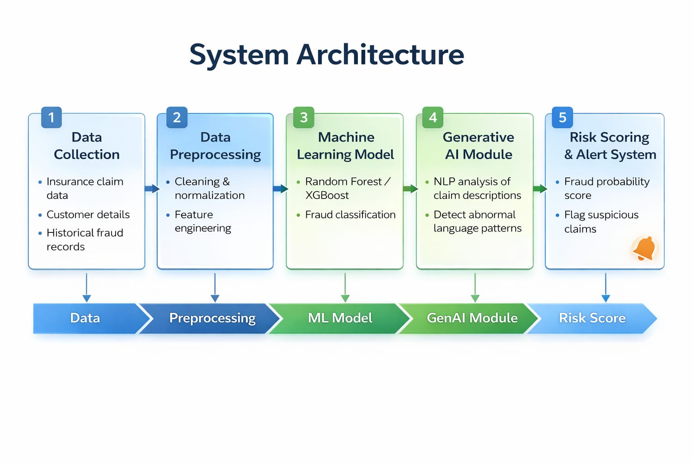

Slide 5

Technology Stack
• Programming Language: Python
• UI Framework: Gradio
• Development Environment: Google Colab
• Fraud Logic: Rule-based prediction model
• Deployment: Gradio Shareable Web Link

Slide 6
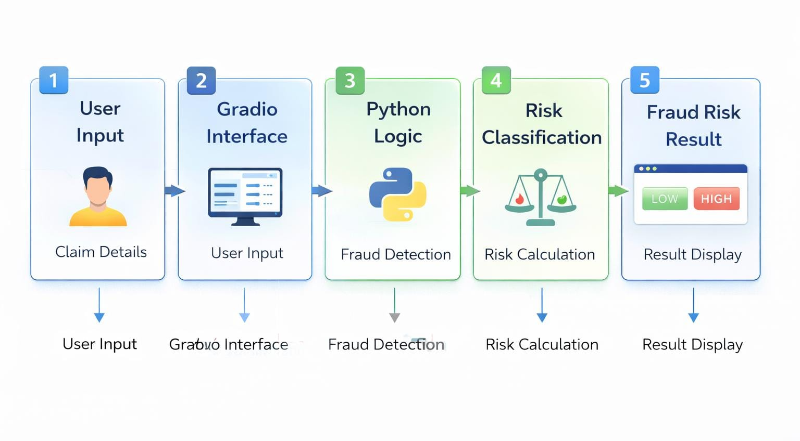
System Working Flow
❖ User enters claim details through the Gradio interface.
❖ Input data is processed by the Python-based fraud detection system.
❖ Fraud prediction logic analyzes claim amount, previous claims, and income.
❖ System calculates fraud risk based on defined conditions.
❖ Claim is classified as High Risk or Low Risk.
❖ Result is displayed instantly to the user.

Slide 7
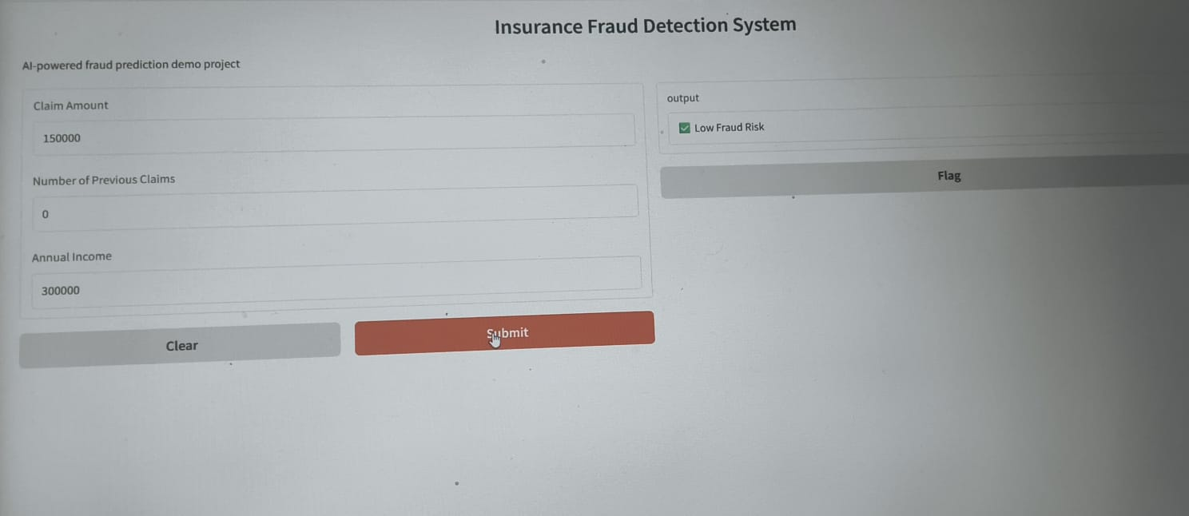
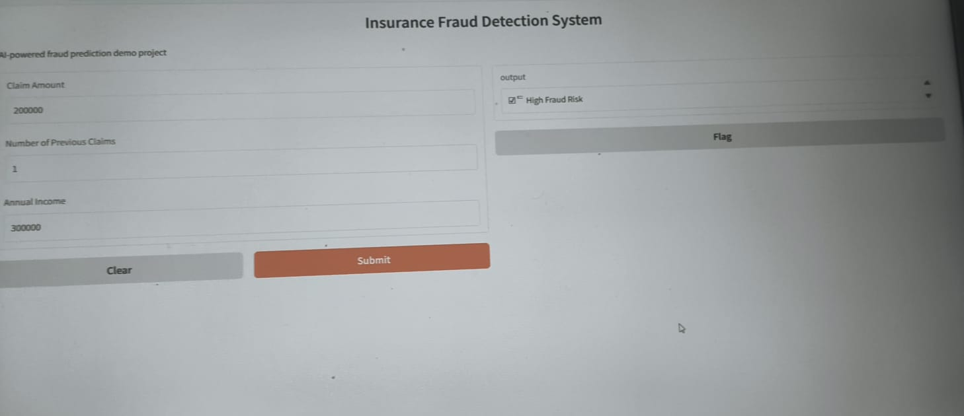
Demo Results
❖ User enters claim amount, previous claims, and annual income.
❖ System processes the input instantly.
❖ Fraud prediction logic evaluates the risk level.
❖ Output displays either High Fraud Risk or Low Fraud Risk.
❖ The result helps investigators take quick decisions.

Slide 8

Conclusion
❖ Successfully designed a smart fraud detection system using AI.
❖ Improves accuracy and speed in claim verification.
❖ Enhances decision-making with automated risk analysis.
❖ Scalable solution for real-world insurance applications.

Slide 9


